Slide 1

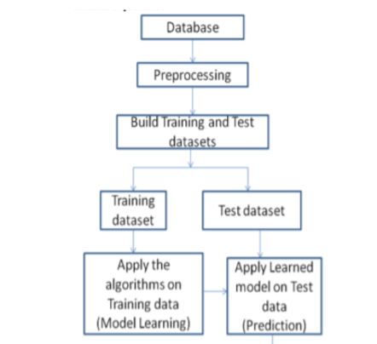
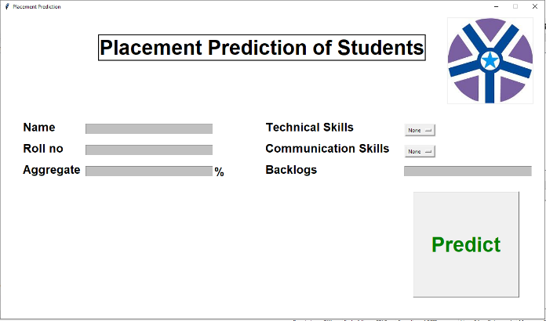
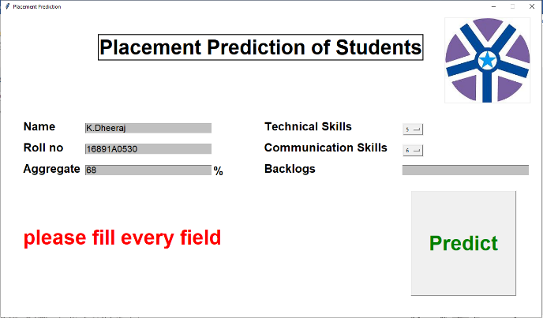
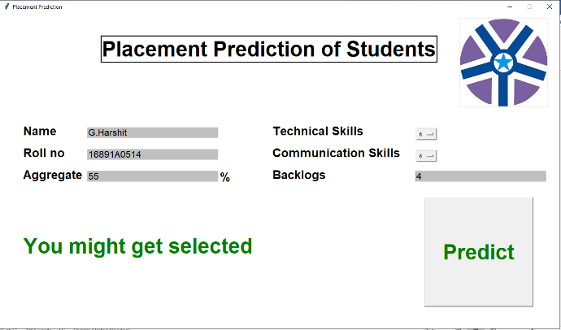
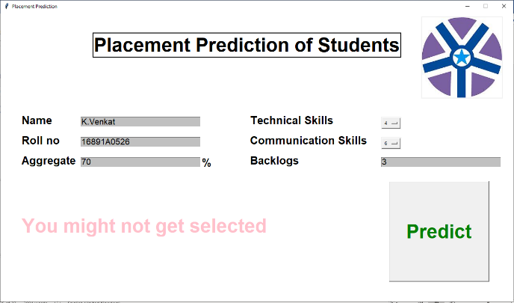
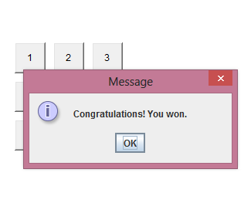
STUDENT PLACEMENT PREDICTION
ABSTRACT
ARCHITECTURE
OUTPUT
This project is basically predicting whether a student will get placed or not,based on some parameters like tech and communication skills.
SRS
Hardware requirements
PROCESSOR:intel corei3
RAM:4GB
HARDDISK:500GB
Software requirements:
OS: Windows 8
-Python modules (Tkinter)
-Machine Learning Algorithms.
-ANACONDA(SPYDER)
BY:
CONCLUSION & SCOPE
M.Swetha(16891A0522)
K.Mahesh(16891A0529)
K.Dheeraj(16891A0522)
GUIDE NAME:
Mrs. P.Lavanya Kumari
Student Placement Prediction is a system which predicts student placement status using machine learning techniques.
All these predictions help the institute to improvise the student performance and can come up with 100% results.

